Slide 1

Key factors of Heart Disease
CZ1115, DSF3 - Group 3
Lin Jiajun (U2021181L)
Max Tan Zheyuan (U2020458H)
Ng Tze Sheng (U2021786C)
Notes:
Greetings. We are Group 3 consisting of Jiajun, Max and Tze Sheng. We are looking to use data science to uncover the key factors of heart disease.

Slide 2




Our Data Pipeline
01. Problem Definition
02. Data Preparation & Cleaning
06. Insights &
Recommendations
03. Exploratory Analysis
05. Model Optimization
04. Machine Learning
Notes:
This is our data pipeline, first we define the problem, then we obtain and prepare a dataset to solve the problem. Next, we perform exploratory analysis on the dataset to draw insights on how best to apply machine learning. The next obvious step is machine learning followed by an optimization process. Lastly, we can draw insights from the results

Slide 3


01. Problem Definition
30%
17.9 M
31.7%
$11 B
World’s data generated via healthcare industry
Lives lost due to Cardiovascular Diseases
Of all deaths in Singapore, 2020
Spent on heart disease treatment in Singapore
Focused Research on Key Factors
1
Early Detection & Prevention
2
Effective Treatment on Key Factors
3
Notes:
Did you know that 30% of the world’s data is generated by the healthcare industry?
Wherever there is data, there is opportunity to apply data science
Why has my team decided to focus in on heart disease?
Well, heart diseases accounts for approximately 17.9 million deaths globally and over 30% of deaths in Singapore. 11 billion dollars is spent on diagnosing and treating it in Singapore alone.
Heart disease is no doubt a big problem.
To counter such a huge problem, we will firstly need focused research on the key factors of heart disease which will enable early detection & prevention or if barring that, effective and targeted treatment

Slide 4



01. Problem Definition
Develop Accurate Model
Get Important Predictors From Model
Data-Driven Decisions
Model must be able to accurately predict heart disease
Determine what are the most important factors in heart disease
Medical Staff, Researchers can focus efforts on these areas
Notes:
Data science can be instrumental in identifying these key factors
By first creating an accurate model to predict the presence of heart disease, we can extract the important predictors.
These important predictors can direct researchers to look into these predictors with the appropriate domain knowledge to generate data-driven insights into how to counter heart disease

Slide 5
Our Data Pipeline
01. Problem Definition
02. Data Preparation & Cleaning
06. Insights &
Recommendations
03. Exploratory Analysis
05. Model Optimization
04. Machine Learning
Notes:
Moving on to data preparation and cleaning

Slide 6
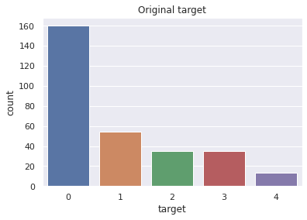
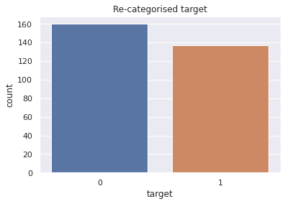




02. Data Preparation & Cleaning
Data Type
NA Values
Categorical/ Continuous
Re-categorize Target
Ensure efficient performance by casting correct data types
NA values in dataset were “?”. Remove observations with NAs
Ensure categorical variables = as.type(‘category’)
Specify prediction to be heart disease = “Yes” or “No”
Notes:
Firstly, after importing the dataset, we must ensure that the variables are casted to the correct data type. For example, age can be an integer instead of a float. This will help performance
Next we checked for NA values which were question marks in this dataset. Since only a small number of rows contain NAs respective to the size of the dataset, we can remove these rows
Thirdly, using the data dictionary, we made sure that categorical variables were set to “category” type
Lastly, in the original dataset, there were 5 categories in the target variable. 0 for no heart disease and 1-4 for varying levels of heart disease. We re-categorized these 5 categories into 2, 0 for no heart disease and 1 for presence of heart disease since we are only interested in whether an individual has or does not have heart disease

Slide 7
Our Data Pipeline
01. Problem Definition
02. Data Preparation & Cleaning
06. Insights &
Recommendations
03. Exploratory Analysis
05. Model Optimization
04. Machine Learning
Notes:
Now, let us move onto exploratory analysis. We made use of data visualization to see the main characteristics of the variables and relationship between variables in our dataset. In this presentation, we will be highlighting 3 important observations that we made, you can find the rest in our submitted code.

Slide 8
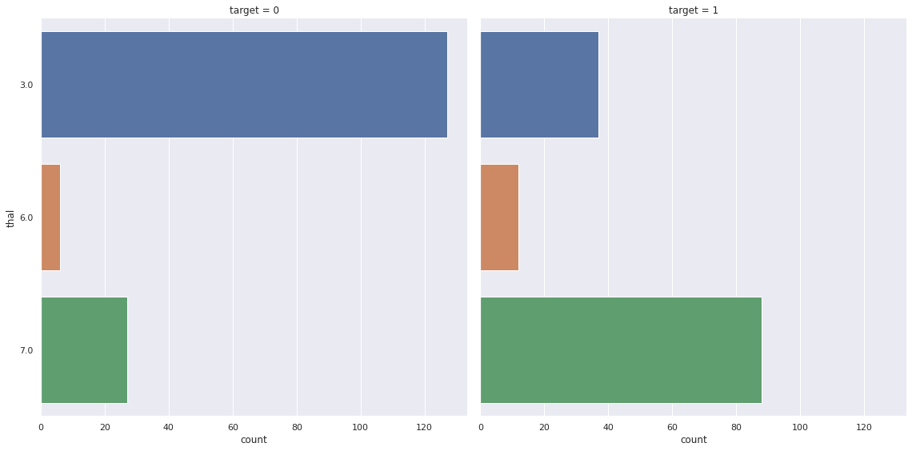
03. Exploratory Analysis
Thalassemia (categorical) vs presence of heart disease (categorical)
Notes:
Firstly, we have a bar chart here. It shows the distribution of a predictor variable “thal” against the target variable. Since 0 represents no heart disease and 1 represents the presence of heart disease, from this graph, we can see that patients with thal = 7 are more likely to have heart disease than patients with thal = 3. This signifies that thal might be an important variable in predicting the target variable.

Slide 9
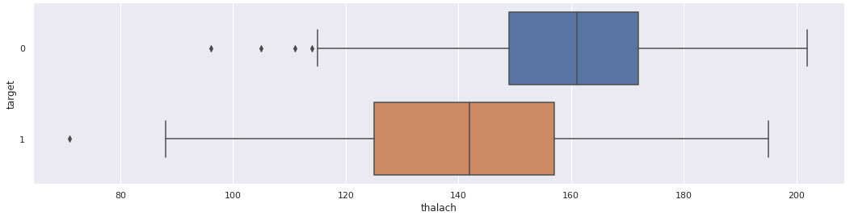
03. Exploratory Analysis
Max. heart rate achieved (continuous) vs presence of heart disease (categorical)
Notes:
Secondly, we have a boxplot of thalach against the target variable. As we can see the two boxplots are distinct, where patients with heart disease have a generally lower thalach than patients without heart disease, with the boxplot of patients with heart disease being lower than that of patients without heart disease. This may also be a sign that thalach is an important variable to predict whether a patient has heart disease.

Slide 10
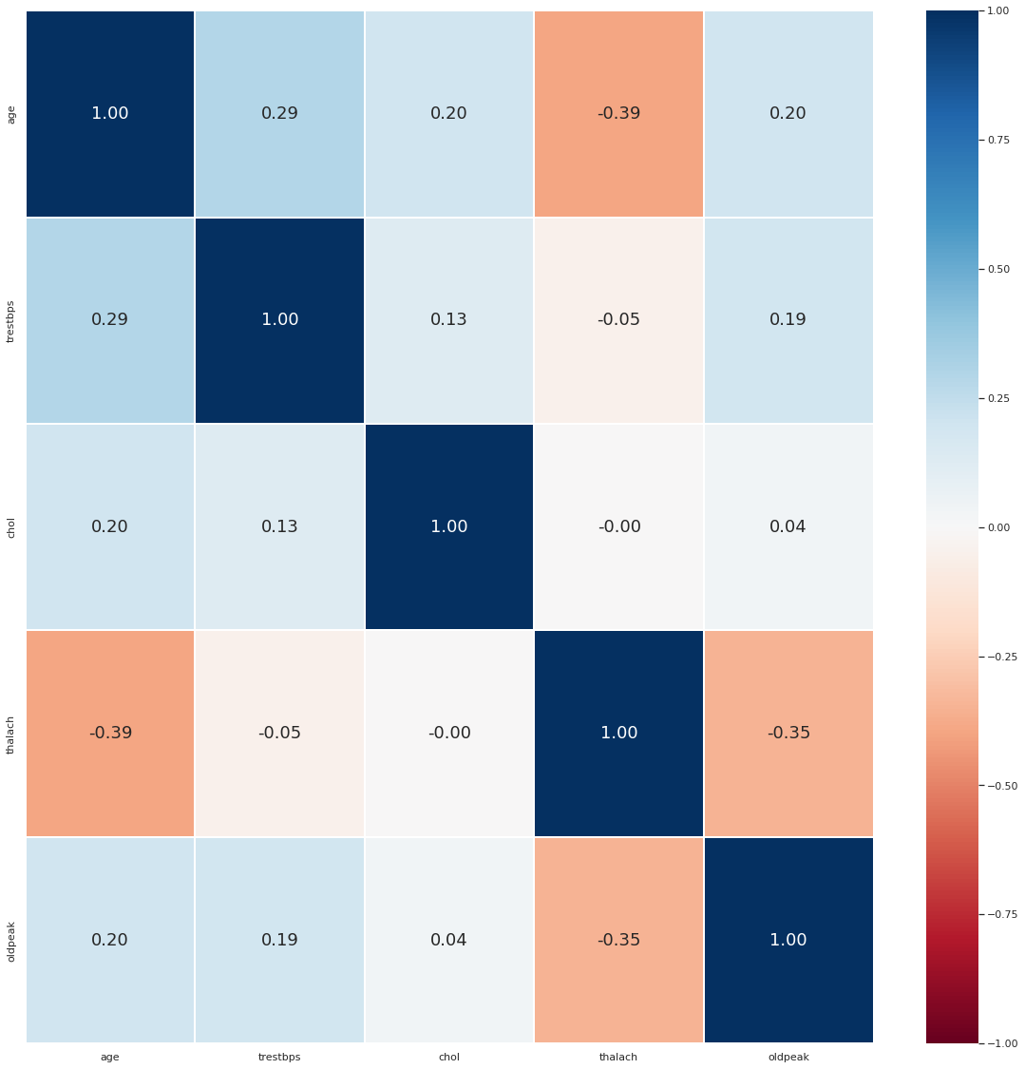
03. Exploratory Analysis
Correlation Plot of Continuous Variables
Search for correlated variables
Multi-collinearity: When independent variables are correlated
Sieving out “redundant” variables
Low correlation
Notes:
Thirdly, we look at a heatmap for the correlation coefficient between continuous predictor variables. This is an attempt to eliminate multi-collinearity, which occurs when independent predictor variables are correlated and this might affect the accuracy of our model. However, from the heatmap, we can see that the correlation coefficient is generally quite low, therefore we do not have a problem of multi-collinearity in our dataset.

Slide 11
Our Data Pipeline
01. Problem Definition
02. Data Preparation & Cleaning
06. Insights &
Recommendations
03. Exploratory Analysis
05. Model Optimization
04. Machine Learning
Notes:
After we have cleaned and explored our data, it is time for us to perform machine learning on it.

Slide 12
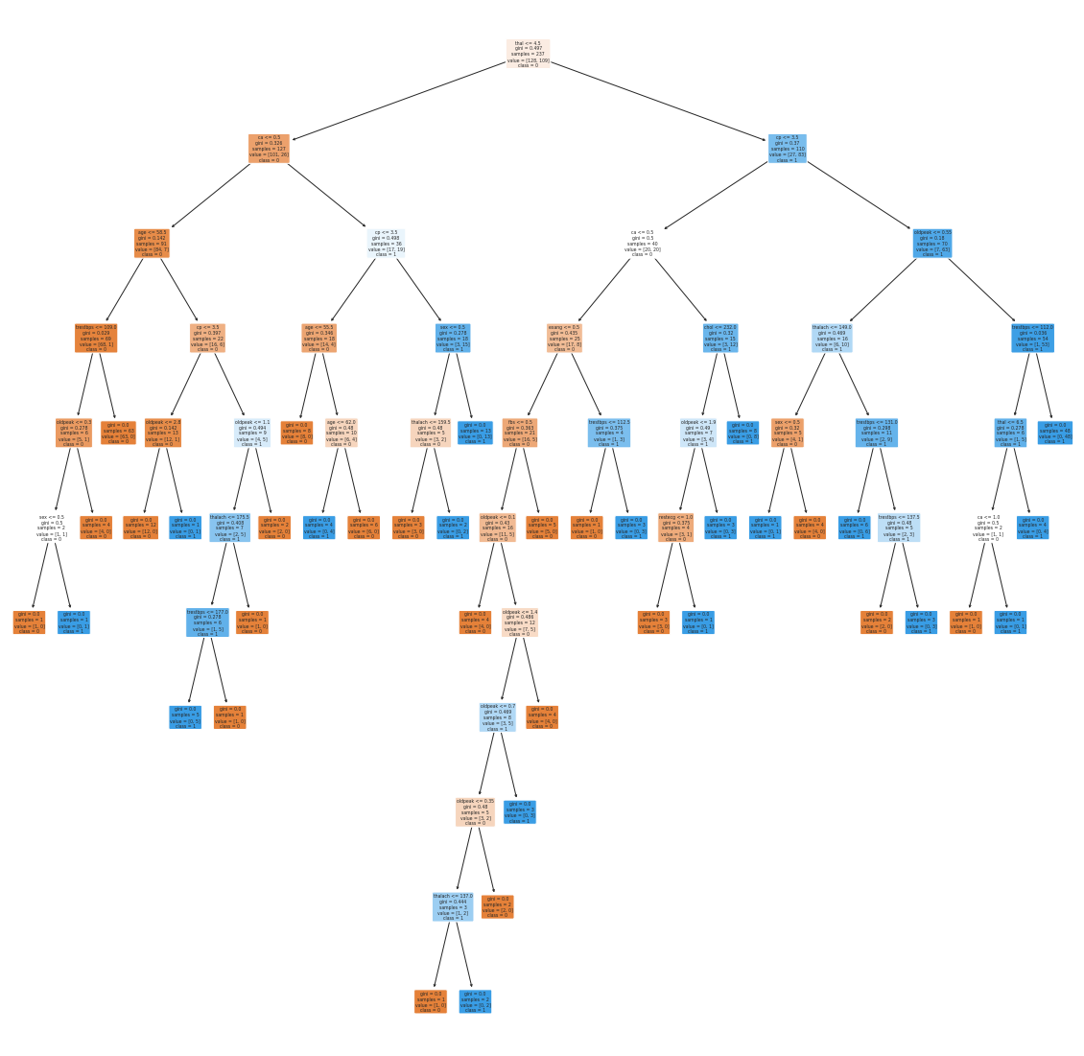
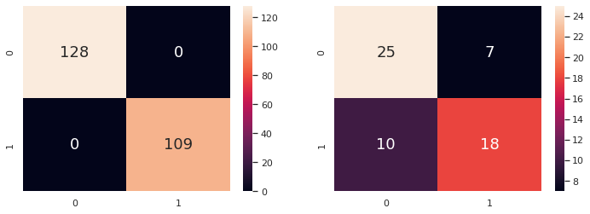
04. Machine Learning
Grow Tree to Maximum Depth
Unknown optimal parameters
Allow initial tree to grow to maximum
Train Set
Test Set
Over-fitting
100%
71.7%
Classification Accuracy
Notes:
For our dataset, we have decided to apply the classification and regression tree model, also known as CART. Since we do not know what are the optimal parameters to go into our optimal CART model, we will allow the tree to grow to maximum by not limiting the max_depth parameter. This produces the decision tree shown on the right side. However, this overfits the trainset data, as seen in a 100% trainset accuracy while the test set accuracy is comparatively a lot lower at about 71%. This means that the maximum tree is picking up and learning from the noise of the trainset, which is not ideal. Therefore, with the maximum tree, we will need to prune the tree and further optimize it.

Slide 13
Our Data Pipeline
01. Problem Definition
02. Data Preparation & Cleaning
06. Insights &
Recommendations
03. Exploratory Analysis
05. Model Optimization
04. Machine Learning
Notes:
The next step of our pipeline involves model optimization.

Slide 14
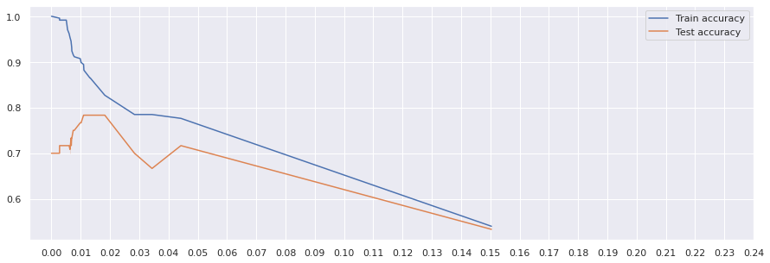
05. Model Optimization
Find Optimal Depth Using cp Values
cp = Complexity parameter
Find cp that gives the maximum test set classification accuracy
cp = 0.015
Notes:
In model optimisation, we look into the possibilities of improving the performance of our models, and an important consideration is also to ensure that our model is not underfitted or overfitted.
For CART, we can optimise this by specifying a complexity parameter or cp. This parameter limits the size of the tree by adding a complexity cost for each node in the tree.
The pruning process begins at the nodes with the weakest links, and an optimal value of cp is one which maximises the test set accuracy.
Here, a value of 0.015 is chosen.

Slide 15
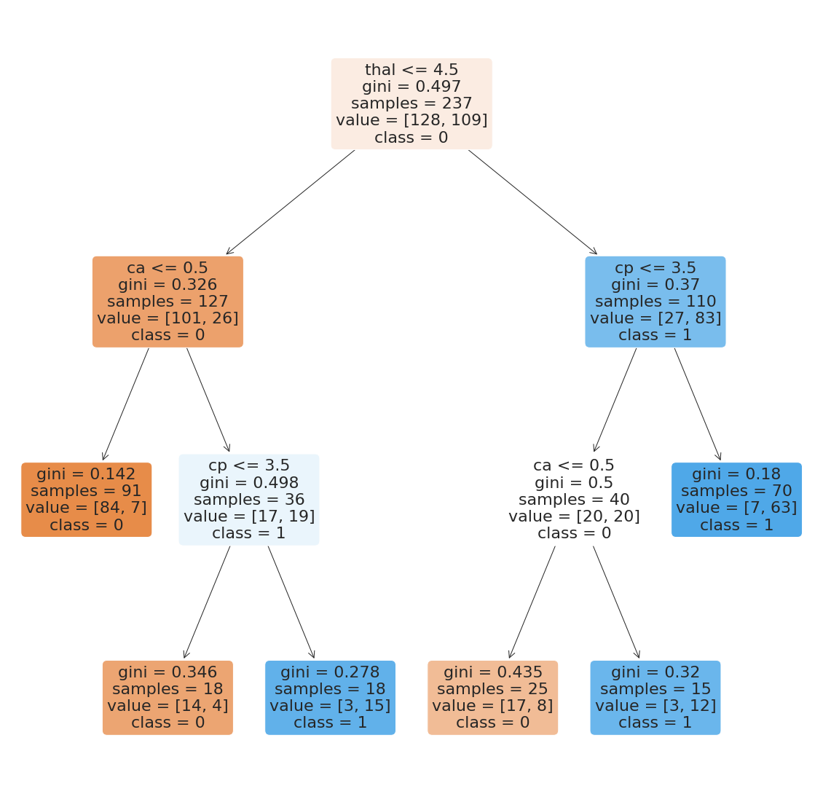
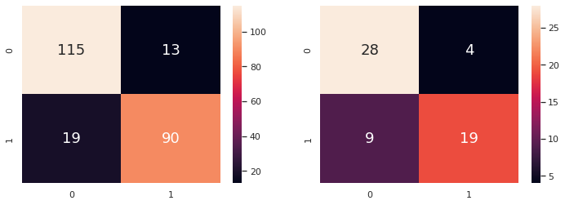
05. Model Optimization
Prune Tree at Optimal cp
Use cp to limit the growth of the tree
Reduce over-fitting of train set
Train Set
Test Set
86.5%
78.3%
Classification Accuracy
Notes:
Looking at the results, the pruned tree is smaller in size and achieves a lower train set accuracy, but a higher test set accuracy.
This is indicative that the tree grown to a maximum previously was overfitting the data, a situation where the model is overly sensitive to the training data and thus performs poorly on test data.

Slide 16

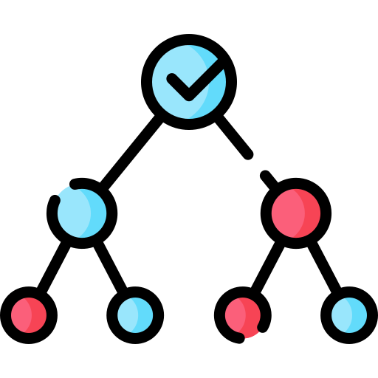
05. Model Optimization
Use Random Forest
Uses bagging & random subset feature selection
Build many trees and aggregate predictions from each tree
Result
Train Set
Test Set
100%
80.0%
Classification Accuracy
. . .
Tree 1
Tree 2
Tree n
Notes:
As a comparison, our team also trained and developed a Random Forest Model.
Random Forest is another machine learning model that is able to handle classification problems, and comprises of many decision trees, often up to 500 different trees. CART on the other hand is only a single tree.
Looking at the results, the random forest model achieved a 100% train set accuracy and 80% test set accuracy.
Now, we may be wondering if the model is overfitted, but random forest utilises bagging and random subset feature selection, which helps us to prevent cases of overfitting the data.

Slide 17
05. Model Optimization
Comparing Results
Model | Class. Acc | TPR | TNR | FPR | FNR
CART | 78.33% | 67.86% | 87.50% | 12.50% | 32.14%
Random Forest | 80.00% | 71.43% | 87.50% | 12.50% | 28.57%
Best Model : Random Forest
Notes:
Comparing both models, we see that the Random Forest model performed better, achieving a higher accuracy and lower rates of error.
The improved performance from optimisation can be significant and thus, our team recommends comparing performances between different models, before make a final recommendation.

Slide 18
Our Data Pipeline
01. Problem Definition
02. Data Preparation & Cleaning
06. Insights & Recommendations
03. Exploratory Analysis
05. Model Optimization
04. Machine Learning
Notes:
Now that we have optimised our model, the next question to ask is what are the insights and recommendations that the models can offer?

Slide 19
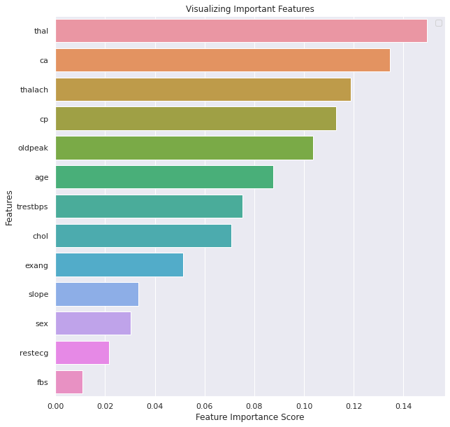
06. Insights & Recommendations
Top Important Factors
Thalassemia (thal): an inherited blood disorder that causes your body to have less haemoglobin than normal
No. of major vessels (0-3) coloured by fluoroscopy (ca)
Maximum heart rate achieved (thalach)
Chest pain type (cp)
Correlation ≠ Causation
Notes:
A strong benefit of the Random Forest model is that it is able to provide a list of important variables, ranking them by their degree of association to the presence of heart disease.
From our model, the top 4 factors were: thalassemia, number of major vessels coloured, maximum heart rate and types of chest pain.
What this means is that these factors played a significant role in accurately predicting the presence of heart disease.
However, an extremely important point to make is that correlation does not equate to causation. Thus, while these factors have been identified to be important in predicting the presence of heart disease, it does not mean that these factors cause heart disease.
Our models only present potential underlying risk factors and medical research and experimentation will be required to determine the actual causality.

Slide 20







06. Insights & Recommendations
Medical Practitioners
Research
Pharmaceuticals
Findings
Public
Notes:
Using our findings as a starting point, medical researchers can refocus their studies into the identified risk factors to determine their exact relationship to heart disease, and the outcomes of the research will prove beneficial to numerous parties.
For medical practitioners, the research findings can help them to better designed treatment plans which would improve the quality of patient care and recovery.
For the pharmaceutical industry, drug-use and development can be tailored to focus on the key risk factors, addressing the disease more effectively.
And for the members of the public, advisories and health tips can be shared to encourage healthy living and promote the mantra of “prevention over cure”.

Slide 21
Our Data Pipeline
01. Problem Definition
02. Data Preparation & Cleaning
06. Insights & Recommendations
03. Exploratory Analysis
05. Model Optimization
04. Machine Learning
Notes:
As we know, the data pipeline forms a cycle and from our findings, new problems can be formulated and lead to further areas of investigation.
We hope that you’ve enjoyed your data science journey and that our project has shed some light into this amazing world of data science. Thank you.

Slide 22
Thank You!
Github repo:

Slide 23
Sources
Links
https://www.rbccm.com/en/gib/healthcare/episode/the_healthcare_data_explosion
https://www.who.int/health-topics/cardiovascular-diseases#tab=tab_1
https://www.myheart.org.sg/my-heart/heart-disease-statistics/
https://www.axa.com.sg/blog/health/hidden-financial-costs-of-a-heart-attack
https://www.analyticsvidhya.com/blog/2020/10/cost-complexity-pruning-decision-trees/

